Slide 1
Linear Regression

Slide 2
Relationship
x Y
2 | 8
6 | 20
4 | 14
3 | 11
7 | 23
4 | 14
2 | 8
5 | 17
Y = ?????????

Slide 3
Relationship
x Y
2 | 8
6 | 20
4 | 14
3 | 11
7 | 23
4 | 14
2 | 8
5 | 17
Y = 2 + 3(X)

Slide 4
What is 2 here?
x Y
2 | 8
6 | 20
4 | 14
3 | 11
7 | 23
4 | 14
2 | 8
5 | 17
Y = 2 + 3(X)

Slide 5
Find the Y in ?
 | x | Y
 | 2 | 8
 | 6 | 20
Y = 2 + 3(X) | 4 | 14
 | 3 | 11
 | 7 | 23
 | 4 | 14
 | 2 | 8
 | 5 | 17
 | 10 | ?
 | 1 | ?

Slide 6
Value for Y with given X
 | x | Y
 | 2 | 8
 | 6 | 20
Y = 2 + 3(X) | 4 | 14
 | 3 | 11
 | 7 | 23
 | 4 | 14
 | 2 | 8
 | 5 | 17
 | 10 | 32
 | 1 | 5

Slide 7
Terminology
x | Y
2 | 8
6 | 20
4 | 14
3 | 11
7 | 23
4 | 14
2 | 8
5 | 17
10 | 32
1 | 5
Y = 2 + 3(X)
Y = Model

Slide 8
Terminology
 | x | Y
 | 2 | 8
 | 6 | 20
Y = 2 + 3(X) | 4 | 14
 | 3 | 11
Y = Model | 7 | 23
2 = Intercept | 4 | 14
 | 2 | 8
 | 5 | 17
 | 10 | 32
 | 1 | 5

Slide 9
Terminology
 | x | Y
 | 2 | 8
 | 6 | 20
Y = 2 + 3(X) | 4 | 14
 | 3 | 11
Y = Model | 7 | 23
2 = Intercept | 4 | 14
3 = Slope | 2 | 8
 | 5 | 17
 | 10 | 32
 | 1 | 5

Slide 10
Terminology
 | x | Y
 | 2 | 8
 | 6 | 20
Y = 2 + 3(X) | 4 | 14
 | 3 | 11
Y = Model | 7 | 23
2 = Intercept | 4 | 14
3 = Slope X = input | 2 5 10 1 | 8 17 32 5

Slide 11
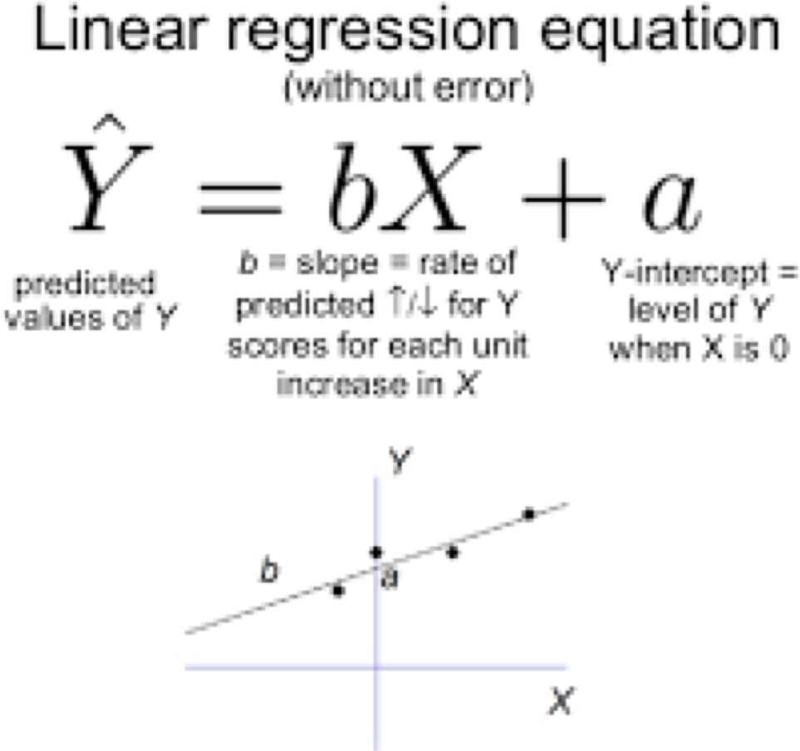
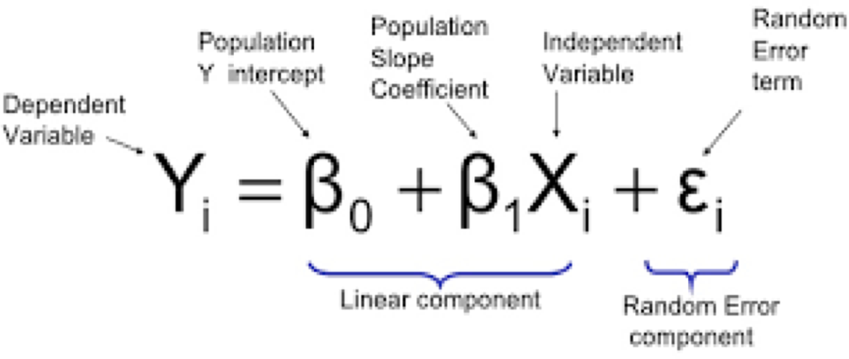
Formula for a line

Slide 12
Linear Regression
Welcome to the world of data science

Slide 13
What is linear?

Slide 14
What is linear?
A Straight line

Slide 15
What is Regression?

Slide 16
What is Regression?
Relationship between two points

Slide 17
What is Linear Regression?

Slide 18
What is Linear Regression?
A Straight line that attempts to predict the relationship between two points

Slide 19
What is Simple Linear Regression?
Simple Linear Regression is a method used to fit the best straight line between a set of datapoints.
After a graph is properly scaled, the data points must “look” like they would fita straight line, not a parabola, or any other shape.
The line is used asa model in order to predict a variable y from another variable x.
Aregression line must involve 2 variables, the dependent and the independent variable.
Finding the “best-fit” line is the goal of simple linear regression.

Slide 20
Definitions:
Input, Predictive, Or Independent Variable X – 3 names mean the same thing. This is the variable whose value that is believed to influence the value of another variable. This variable should not be dependent on another variable (bydefinition)
Output, Response, Or Dependent Variable Y – 3 names mean the same thing. This is the variable whose value that is believed to be influenced by the value of another variable. It is by definition, dependent on another variable.
Best-Fit Line – Represents our model. It is the line that “best fits” our data points. The line represents the best estimate of the y value for every given input of x.
Sum Of Squares – An important calculation we will use to find the best-fit line.

Slide 21
One Variable

Slide 22
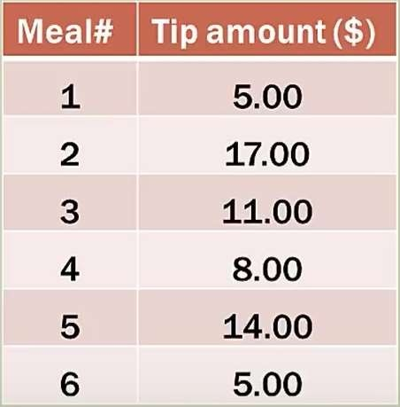
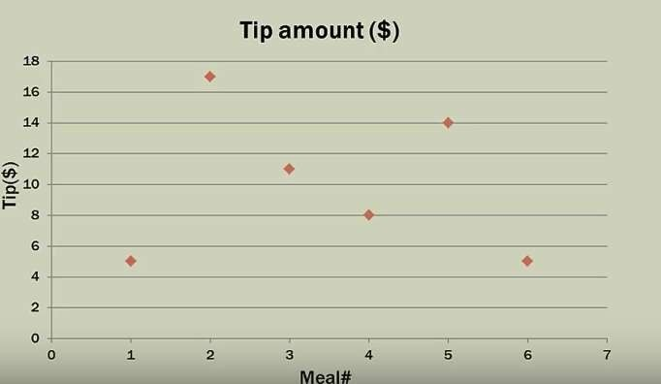
Problem: A waiter wants to predict his next tip, but he forgot to record the bill amounts for previous tips.
Here is a graph of his tips. The tips is the only variable. Let’s call it the y variable.
Meal#is not a variable. It is simply used to identify a tip.
y variable
Can we come up with a model for this problem with only 1 variable?

Slide 23
The only option for our model is to use the mean of the Tips($)
Tips are on the y access. We would call the mean !(y bar).
The mean for the tip amounts is10.
The model for our problem is simply!=10.
!=10 is our best fitline (represented by bold blackline).
!= 10

Slide 24
Now, let’s talk about goodness of fit. This will tell us how good our data points fit theline.
We need to calculate the residuals (errors) for eachpoint.
+7
+1
+4
-2
!= 10
-5
-5

Slide 25
The best fit line is the one that minimizes the sum of the squares of the residuals (errors).
The error is the difference between the actual data point and the point on the line.
SSE (Sum Of Squared Errors) =(-5)²+ 7²+ 1²+(-2) ²+ 4²+(-5)²= 120
+7
+1
+4
-2
!= 10
-5
-5
SST (Sum Of Squared Total) = SSR (Sum Of Squared Regression) + SSE is the Sum Of Squares Equation.
Since there is no regression line (as we only have 1 variable), we can not make the SSE any smaller than 120, because SSR =0.

Slide 26
Two Variables

Slide 27
Goal Of Simple Linear Regression
The goal of simple linear regression is to create a linear model that minimizes the sum of squares of the errors (SSE).
From a previous slide: SST (Sum Of Squared Total) = SSR (Sum Of Squared Regression) + SSE When we have 2 variables, we can create a regression line; and therefore, we can calculate an SSR> 0. If SSR> 0, then we can reduce SSE. Minimizing the errors means that the line will fit the data better.
2 variables: One is the dependent variable: y. The other is the independent variable x.

Slide 28
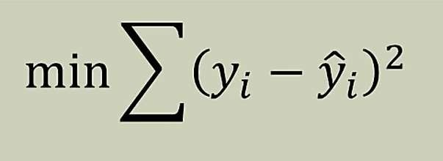
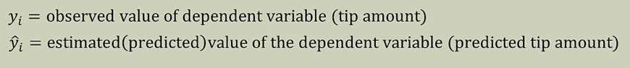
Sonow, we need to introduce a little math…..
Remember from the previous slide that we want to
minimize the SSE.
We write this mathematically this way.:
!is often referred to as y-hat.

Slide 29
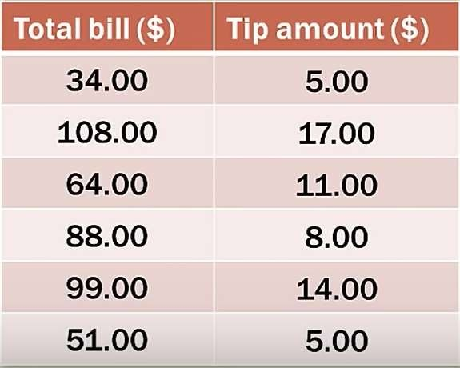
Repeating the Problem: As a waiter, how do we predict the tips we will receive for service rendered?
Let’s say, we didn’t forget to record the billamount.
Independent Variable (x)
Dependent Variable (y)

Slide 30
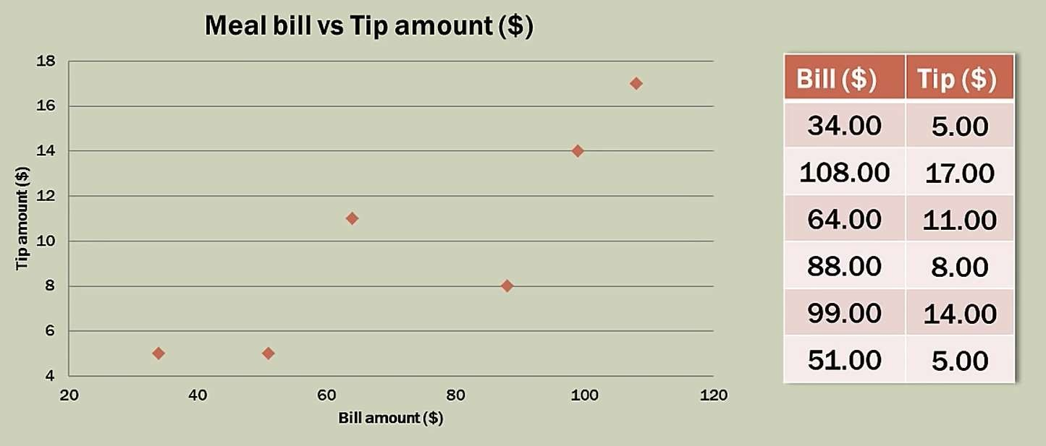
If we scale the graph according to the data points available, we can then plot the points.

Slide 31
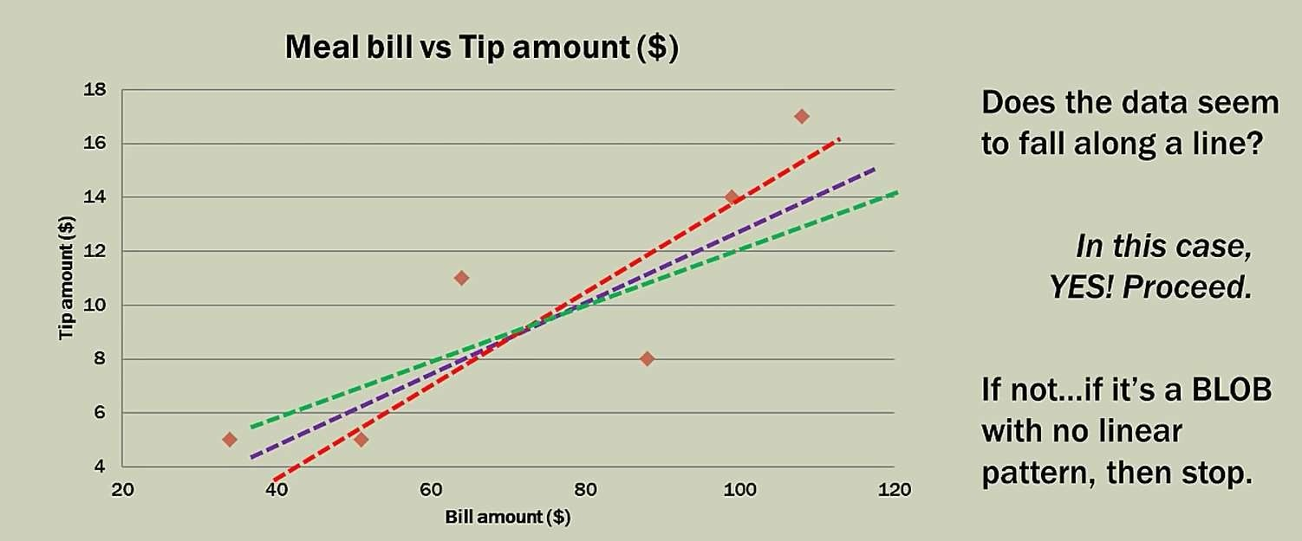

Slide 32
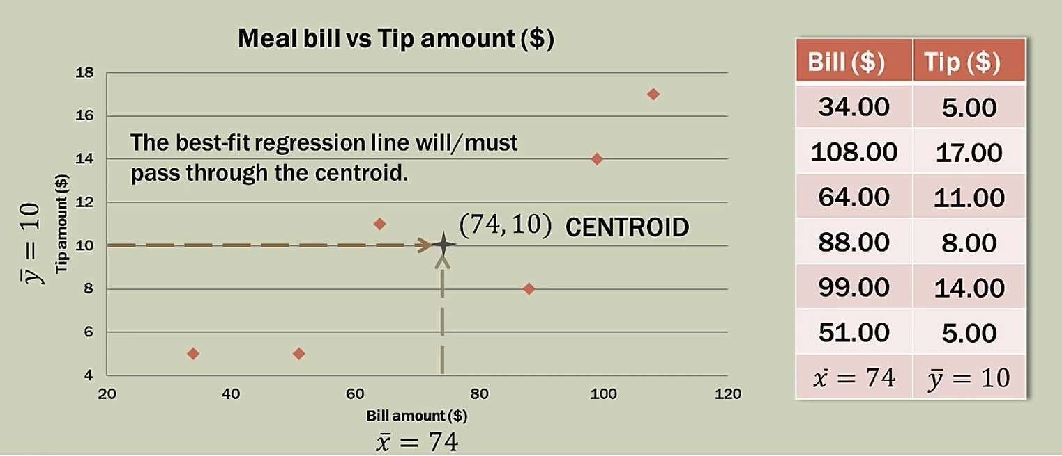

Slide 33


Algebra Of Lines - Slope
y
run
•
rise
x_{j}, y_{j}
x•,y
i i
(0,b)
x
Equation Of A Straight Line Y= mX + b
slope y-intercept
m = (rise/run) = (y_{j –} y_{i) /} (x_{j –}x_{i})
b is the point where x = 0 and y intersects the y-axis

Slide 34
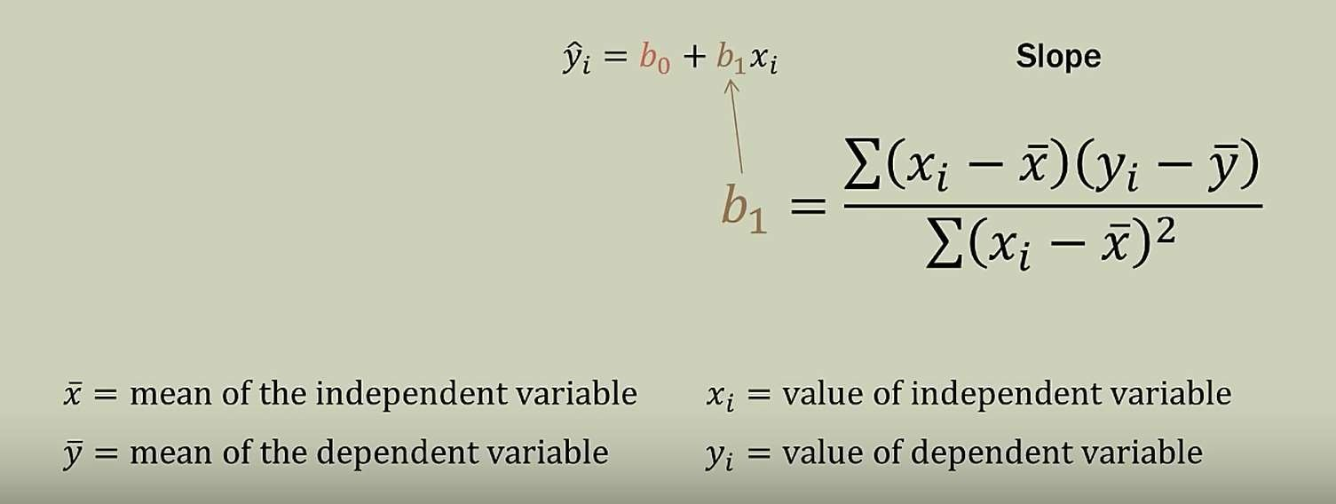
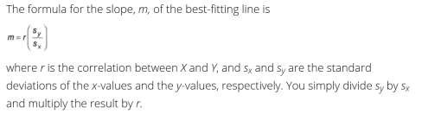
Regression Line - Slope
Think of s_{y} divided by s_{x} asthe variation (resembling change) in Y over the variation in X, in units of Xand Y. RiseOver Run!
Derivation to this

Slide 35
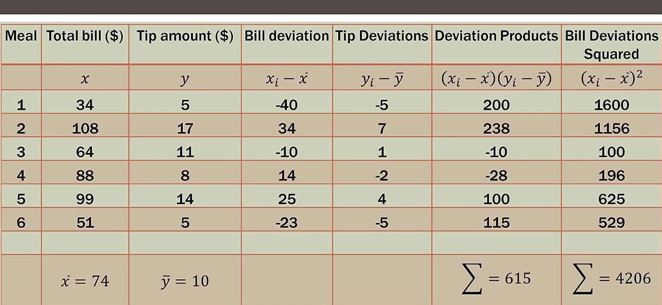
Let’s create a table of calculations that we can use to calculate the slope of the regression (best-fit)line.

Slide 36
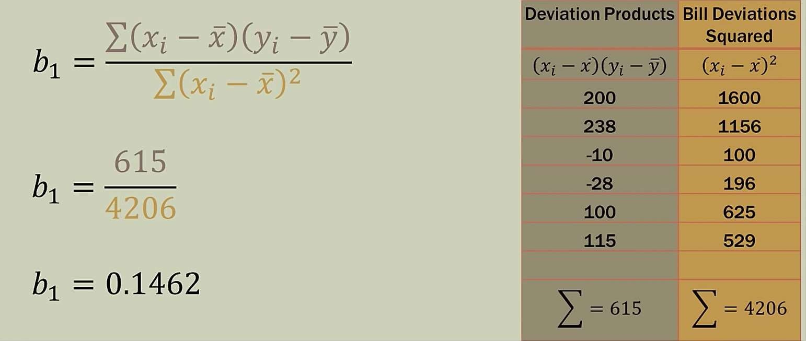

Slide 37
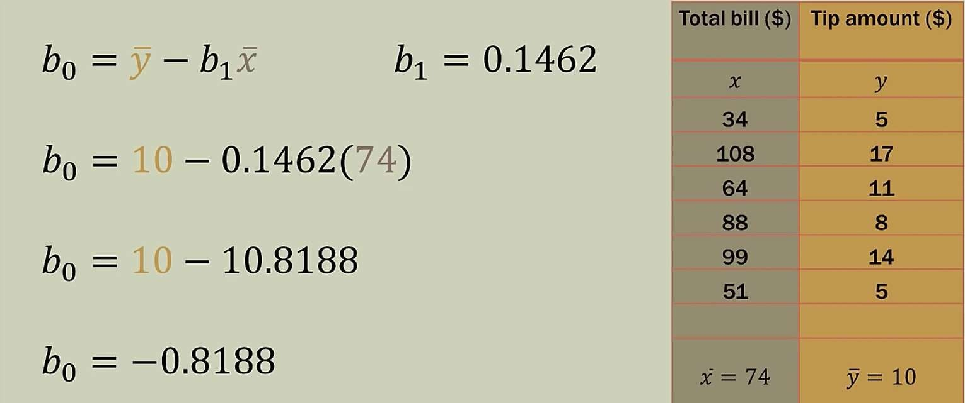
Now that we have the slope, we can calculate the y-intercept because we know 1 point on the line already (74,10).
What do we call 74,10?

Slide 38
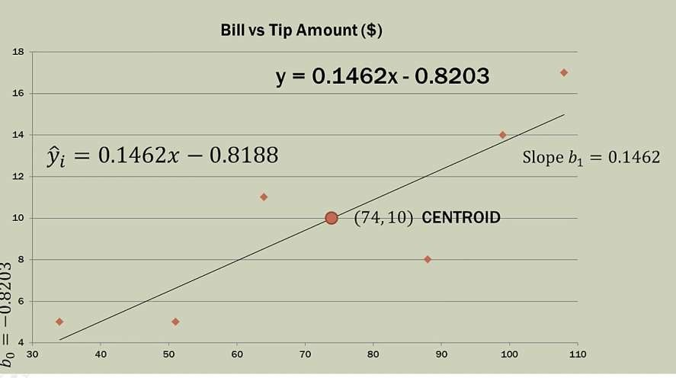
(74,10) is the Centroid.
For comparison, Excel has calculated the regression equation very close to our manual calculation.

Slide 39
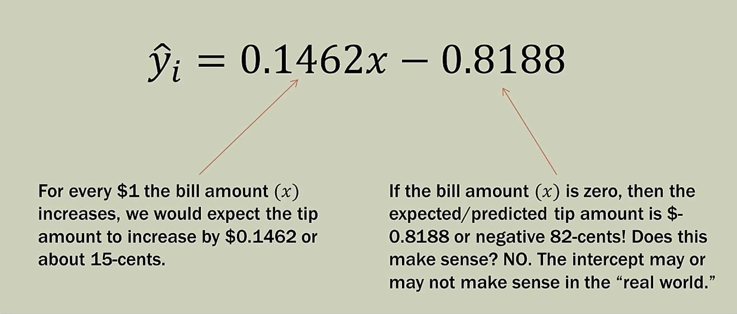
Meaning of our equation….

Slide 40
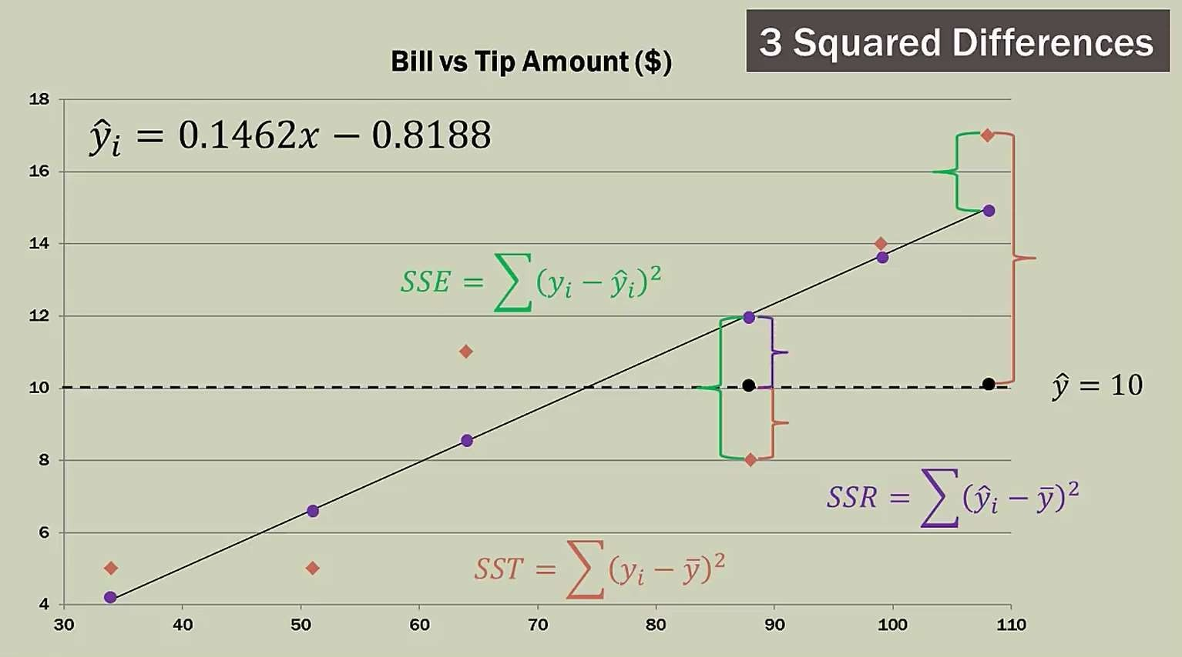
SST= SSR+ SSE

Slide 41
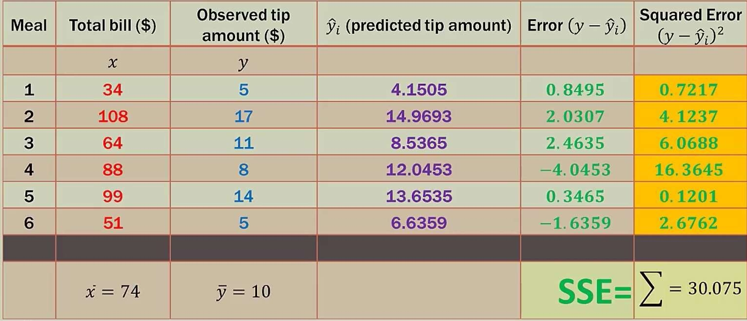

Slide 42
Gradient Descent

Slide 43
Linear Regression with Gradient Descent
Gradient descent is a first-order iterative optimization algorithm for finding the minimum of a function.

Slide 44
Linear Regression with Gradient Descent
Gradient descent is a first-order iterative optimization algorithm for finding the minimum of a function.

Slide 45
Linear Regression with Gradient Descent
Gradient descent is a first-order iterative optimization algorithm for finding the minimum of a function.

Slide 46
Linear Regression with Gradient Descent
Gradient descent is a first-order iterative optimization algorithm for finding the minimum of a function.

Slide 47
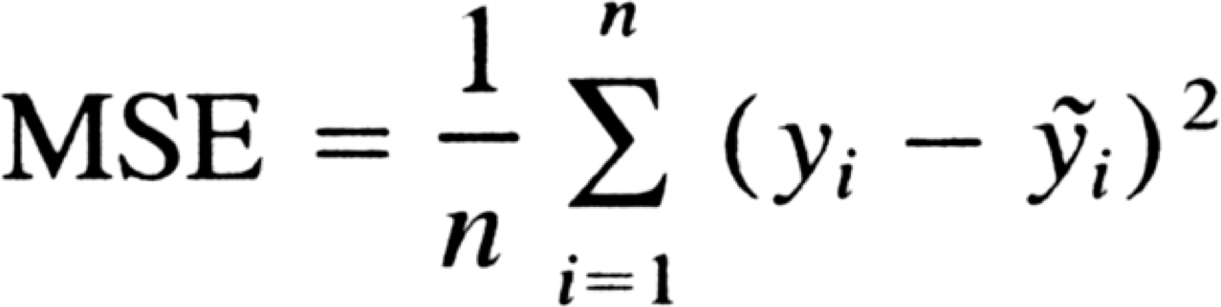
Linear Regression with Gradient Descent
By tweaking m and b, we can create a line that will best describe the relationship. How do we know we’re close? By using a thing called a cost function. It literally tells us the cost.
A high cost value means it’s expensive — our approximation is far from describing the real relationship. On the other hand, a low cost value means it’s cheap— our approximation is close to describing the relationship.

Slide 48
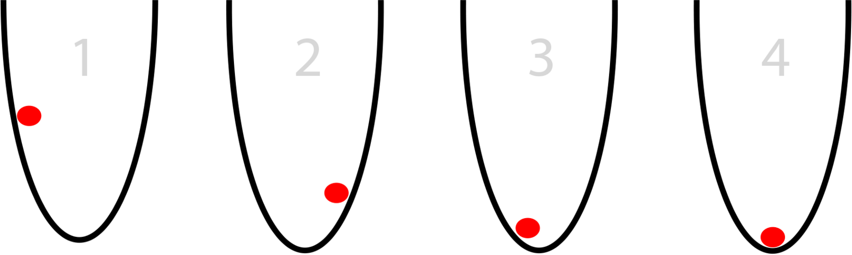
Linear Regression with Gradient Descent
Brute force isn’t helpful. A more efficient way is gradient descent. Imagine trying to find the lowest point blindfolded as can be seen below. What you would do is to check left and right and then feel which one brings you to a lower point. You do this every step of the way until checking left and right both brings you to a higher point.

Slide 49
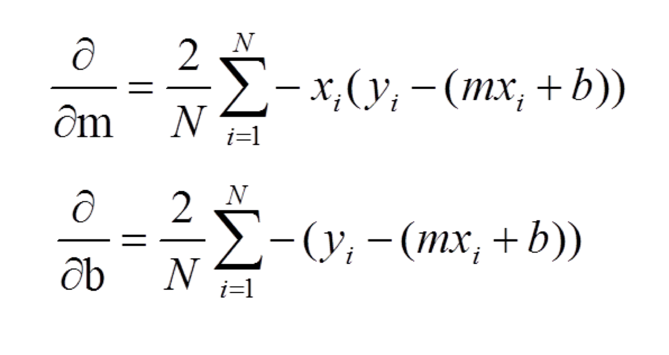
Linear Regression with Gradient Descent
What we’re doing here is applying partial derivatives with respect to both m and b to the cost function to point us to the lowest point.
derivative of zero means you are at either a local minima or maxima
Which means that the closer we get to zero, the better.

Slide 50
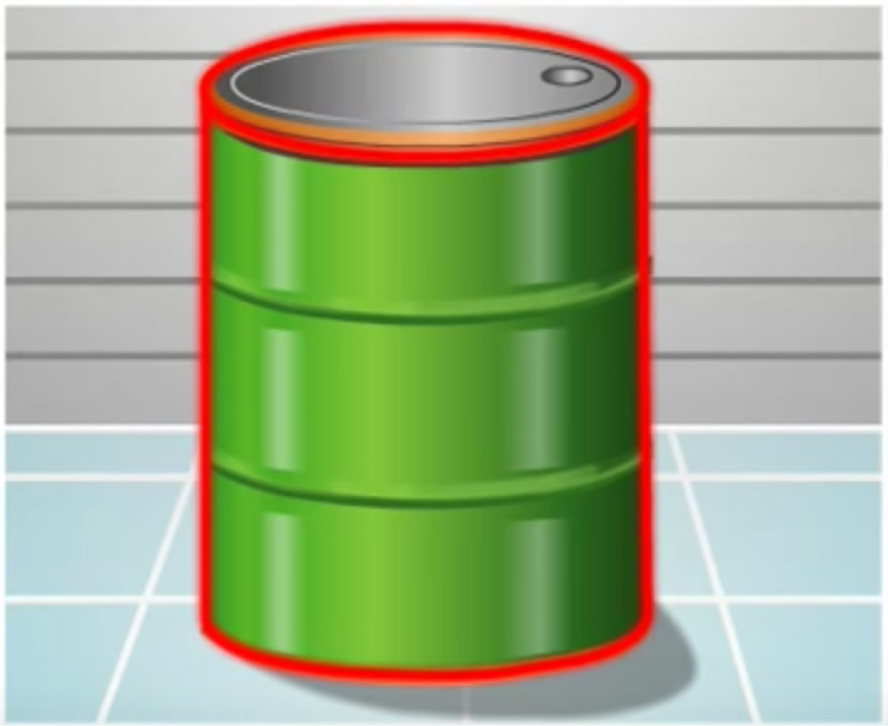
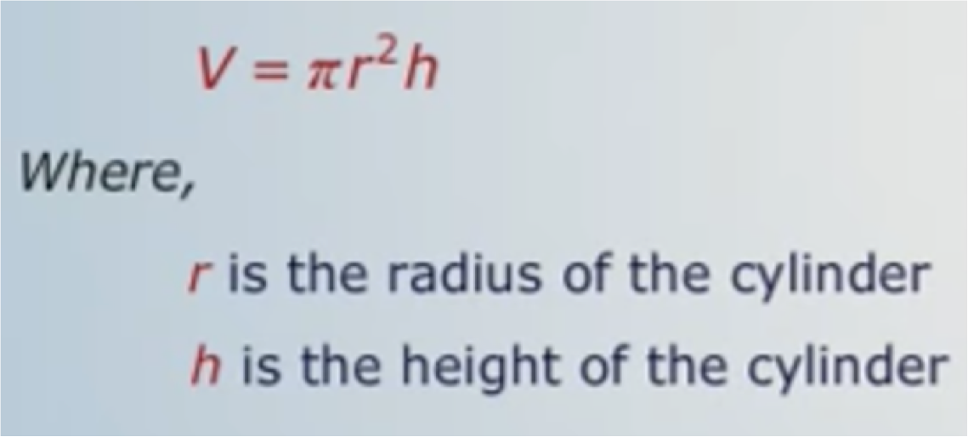
What is partial derivative?
Let us understand the function of several variables
Volume of cylinder

Slide 51
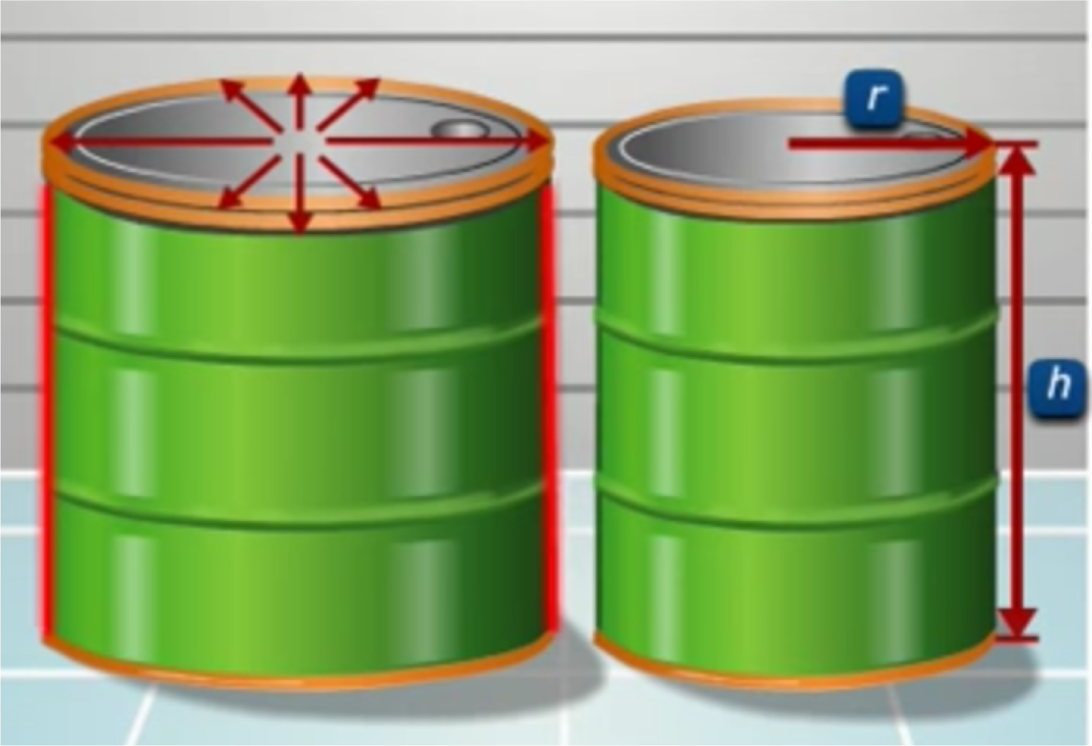
What is partial derivative?
When we change value of r no Change in h

Slide 52
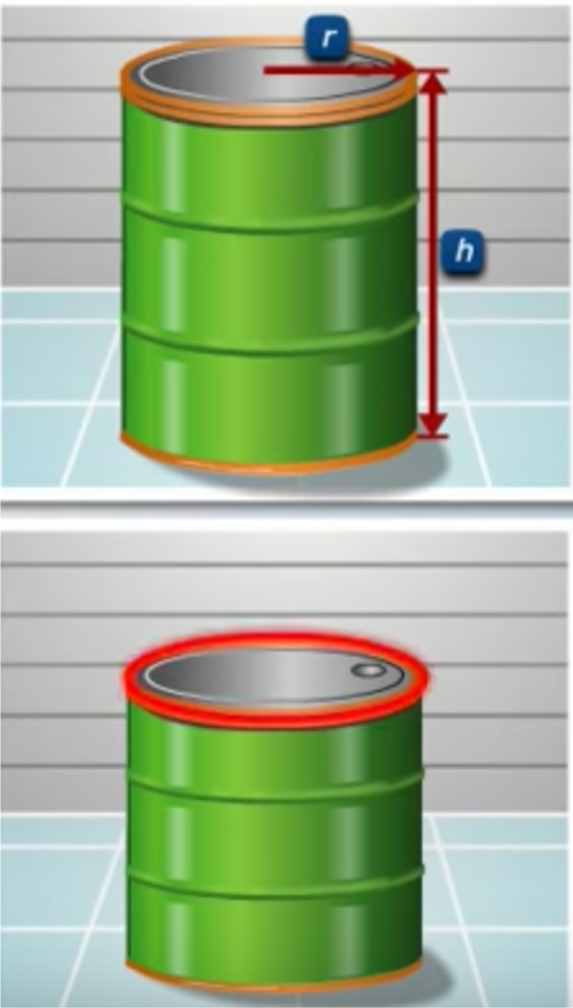
What is partial derivative?
When we change value of h no Change in r

Slide 53
What is partial derivative?
Therefore we see that
If r changes, is no change in h and vice versa.
Therefore r and h are independent variables.
Therefore, V is an example of Function of several variables

Slide 54
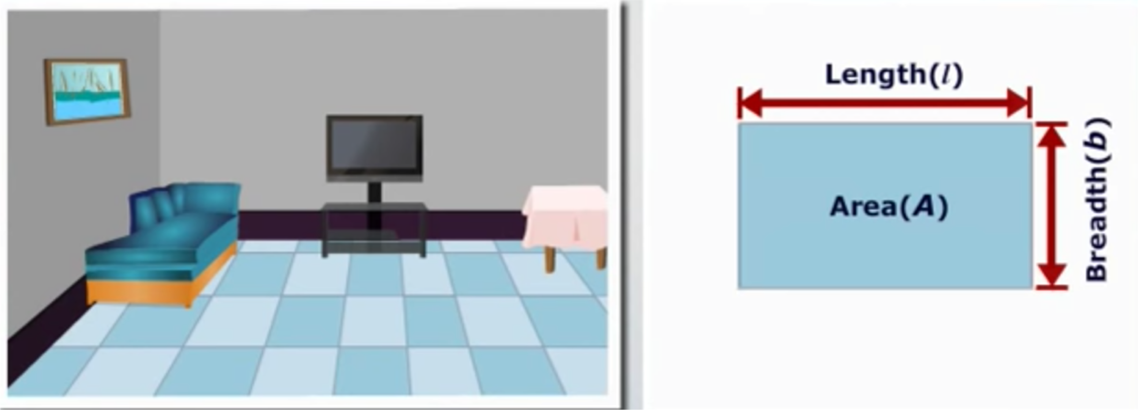
What is partial derivative?

Slide 55
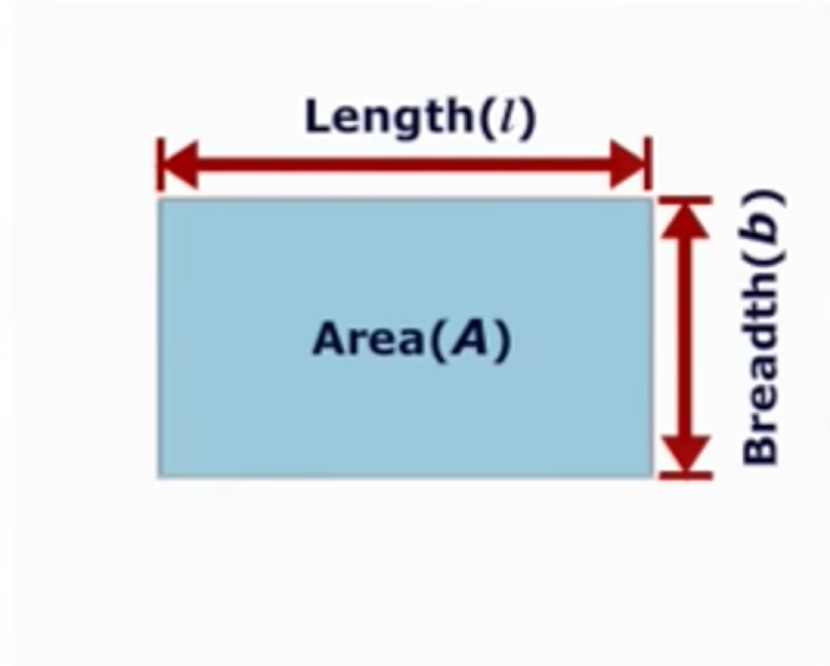
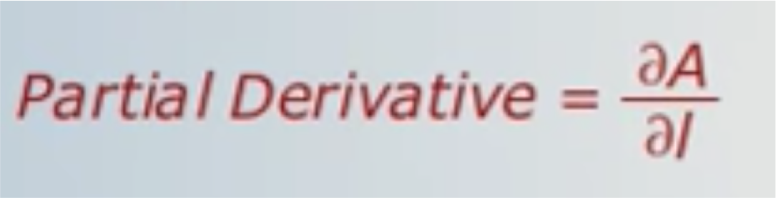
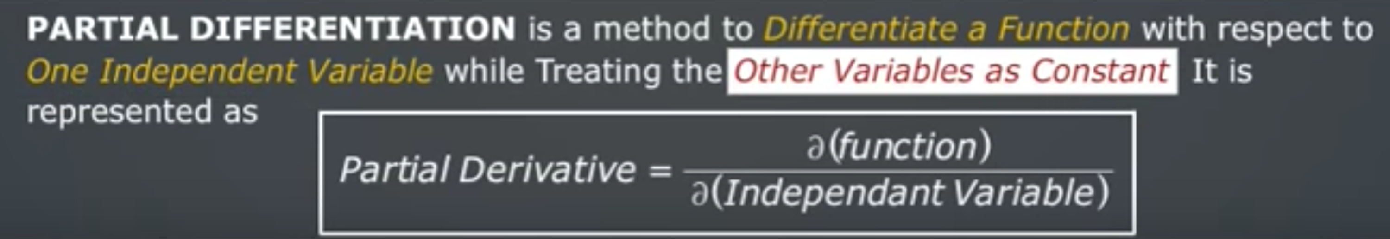
What is partial derivative?
Area, A = l x b
Rate of change of Area wrt Length
Area, A = l x b (we will make b as constant)

Slide 56
Linear Regression with Gradient Descent
Step 1: Substitute m and b to zero
Step 2: Find the prediction and cost function. ie. summation(y-(mx+b))^2
Step 3: Find b_gradient and m_gradient by substituting in partial derivative function
Step 4: Update b and m by with respective to gradient value found in step 3 with learning rate
Step 5: Find the cost function and repeat step 2 to 4

Slide 57
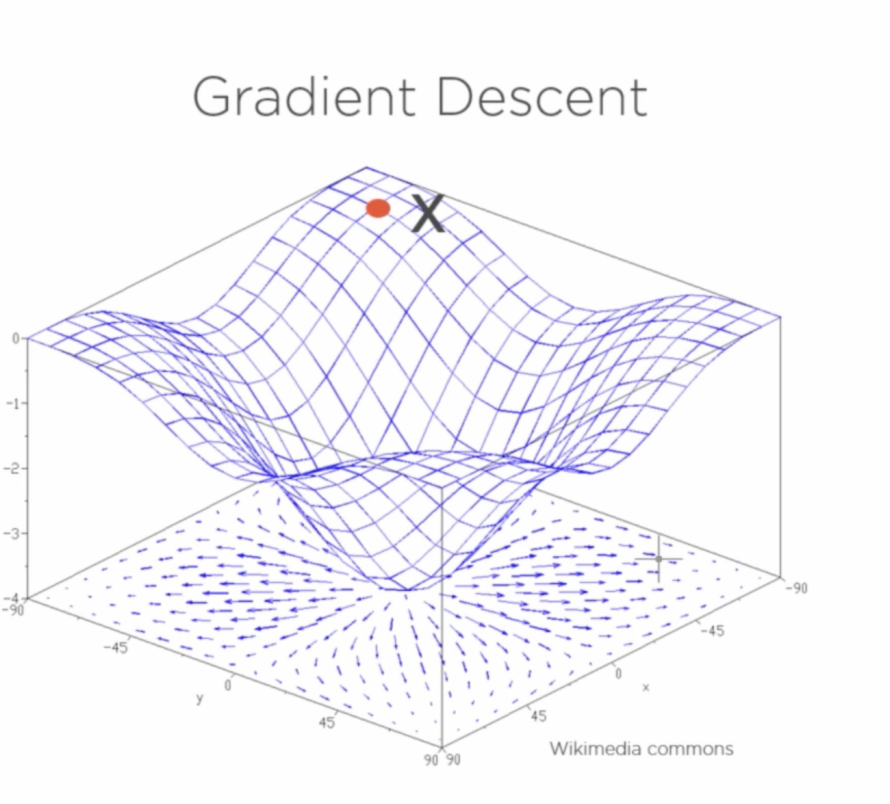

Slide 58
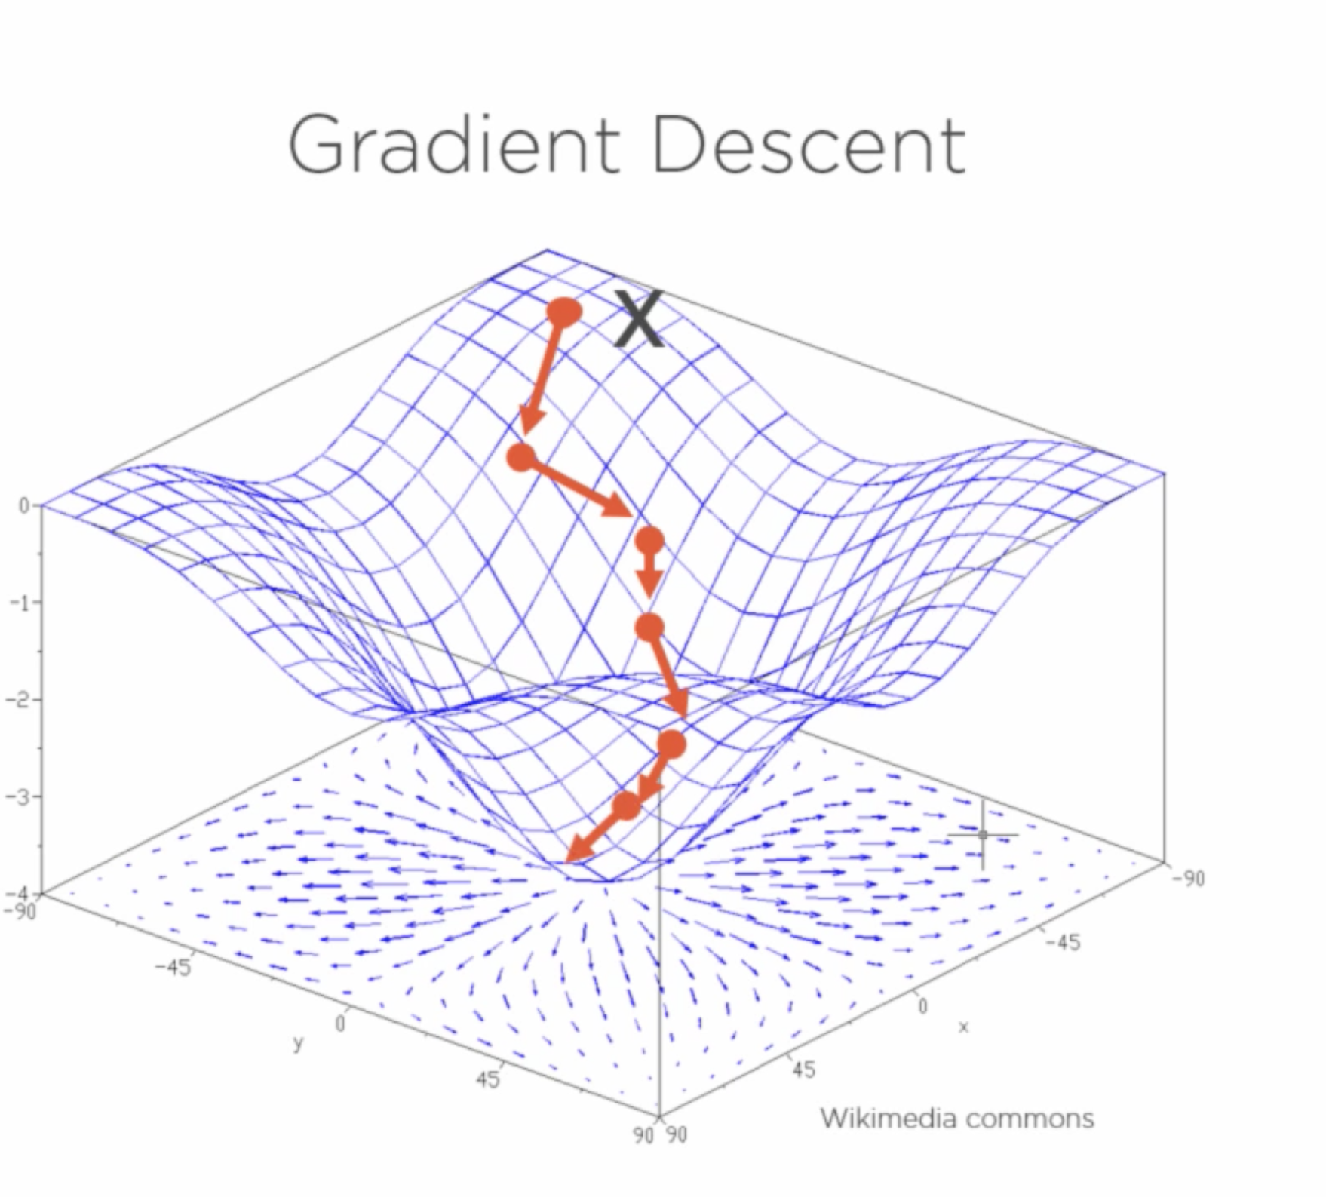

Slide 59
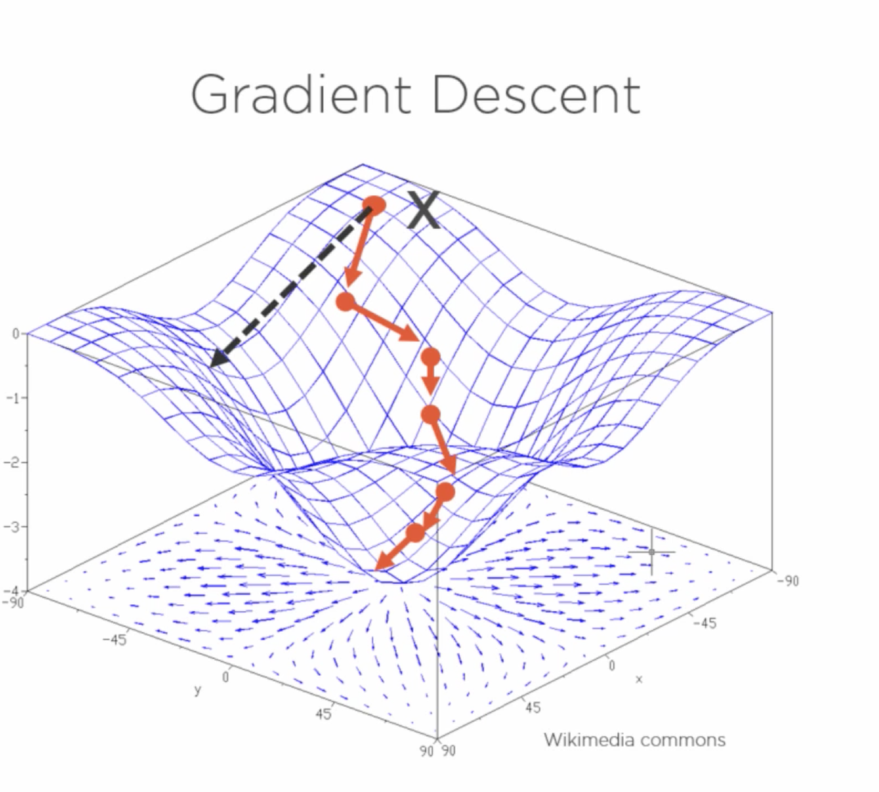

Slide 60
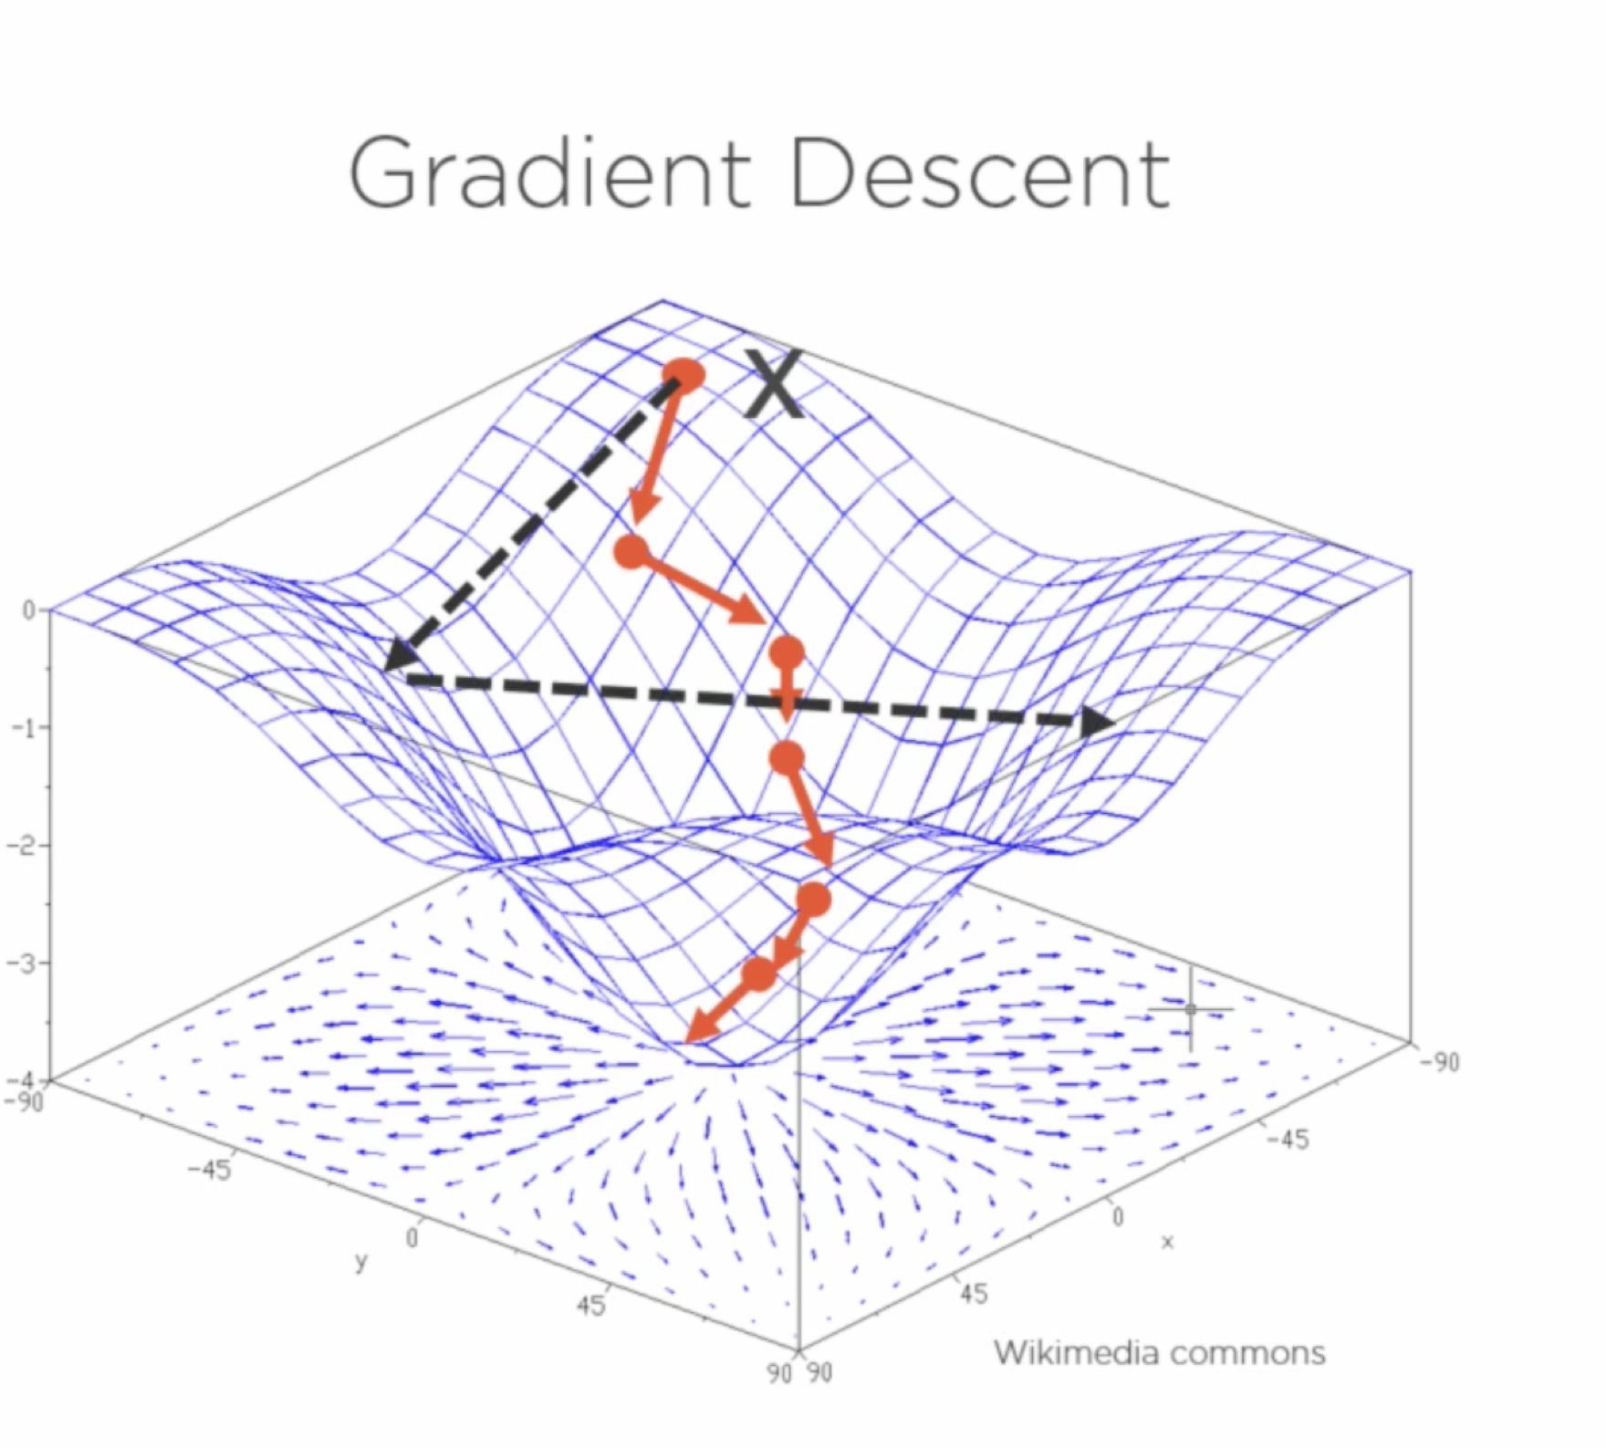

Slide 61
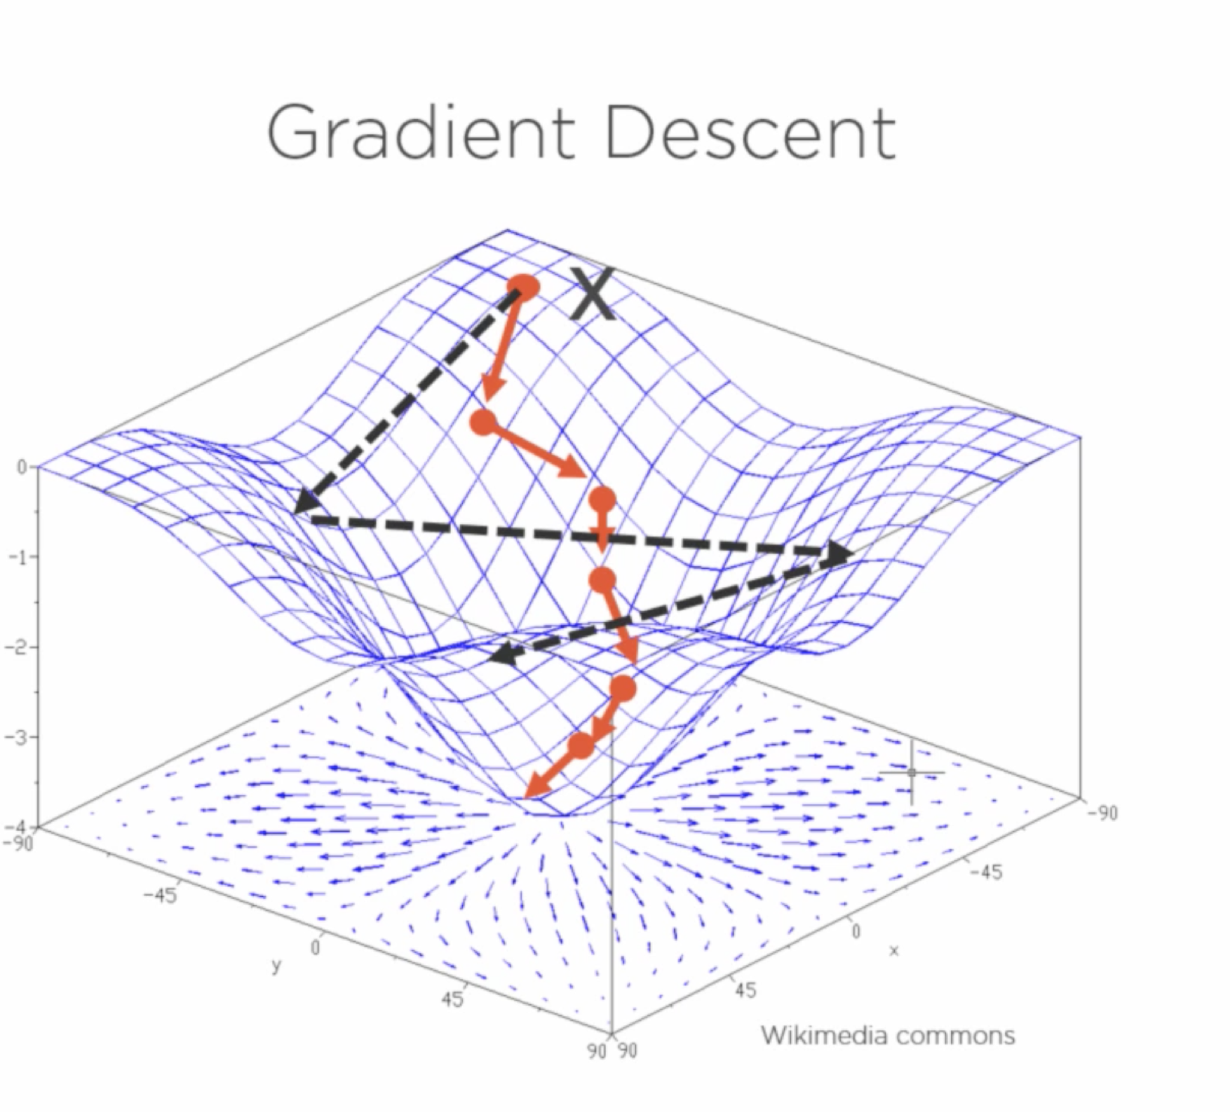

Slide 62
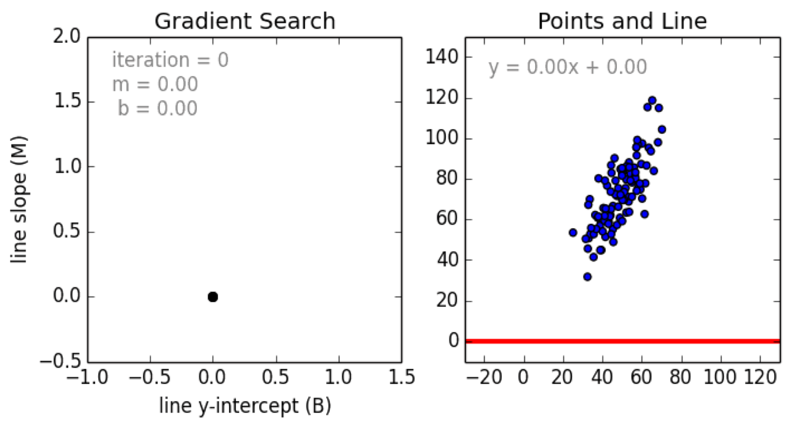
Gradient Descent

Slide 63
Coefficient of Determination, R²
The coefficient of determination is the portion of the total variation in the dependent variable that is explained by variation in the independent variable
The coefficient of determination is also called R-squared and is denoted as R²
_{R2 =} SSR
2
where
0 ≤ R ≤ 1
SST

Slide 64
Coefficient of Determination, R²
Coefficient of determination
_{R2 =} SSR ₌ sum of squares explained by regression SST total sum of squares
Note: In the single independent variable case, the coefficient of determination is
R² = r²
where:
R² = Coefficient of determination r = Simple correlation coefficient

Slide 65






Examples of Approximate R²
Values
y
R² = 1
Perfect linear relationship between x and y:
x
R² = 1
y
100% of the variation in y is explained by variation in x
x
R² = +1

Slide 66







Examples of Approximate R²
Values
y
0 < R² < 1
Weaker linear relationship between x and y:
x
Some but not all of the variation in y is explained by variation in x
y
x

Slide 67

Examples of Approximate R² Values
R² = 0
y
No linear relationship between x and y:
The value of Y does not depend on x. (None of the variation in y is explained by variation in x)
R² = 0
x

Slide 68
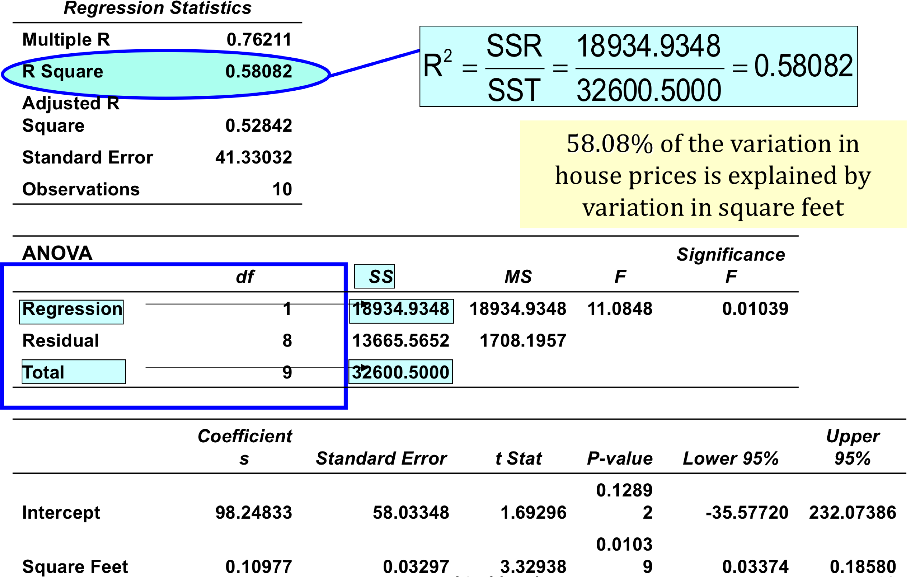
Output

Slide 69
Standard Error of Estimate
The standard deviation of the variation of observations around the regression line is estimated by
SSE
s =
ε
n − k −1
Where
SSE = Sum of squares error n = Sample size
k = number of independent variables in the
model

Slide 70
The Standard Deviation of the Regression Slope
The standard error of the regression slope coefficient (b₁) is estimated by
s_{ε} s_{ε}
∑(x − x)²
s =
=
b₁
_{∑x}2
(∑ x)²
−
n
where:
s_{b}
= Estimate of the standard error of the least squares slope
1
SSE
s =
= Sample standard error of the estimate
ε
n − 2

Slide 71
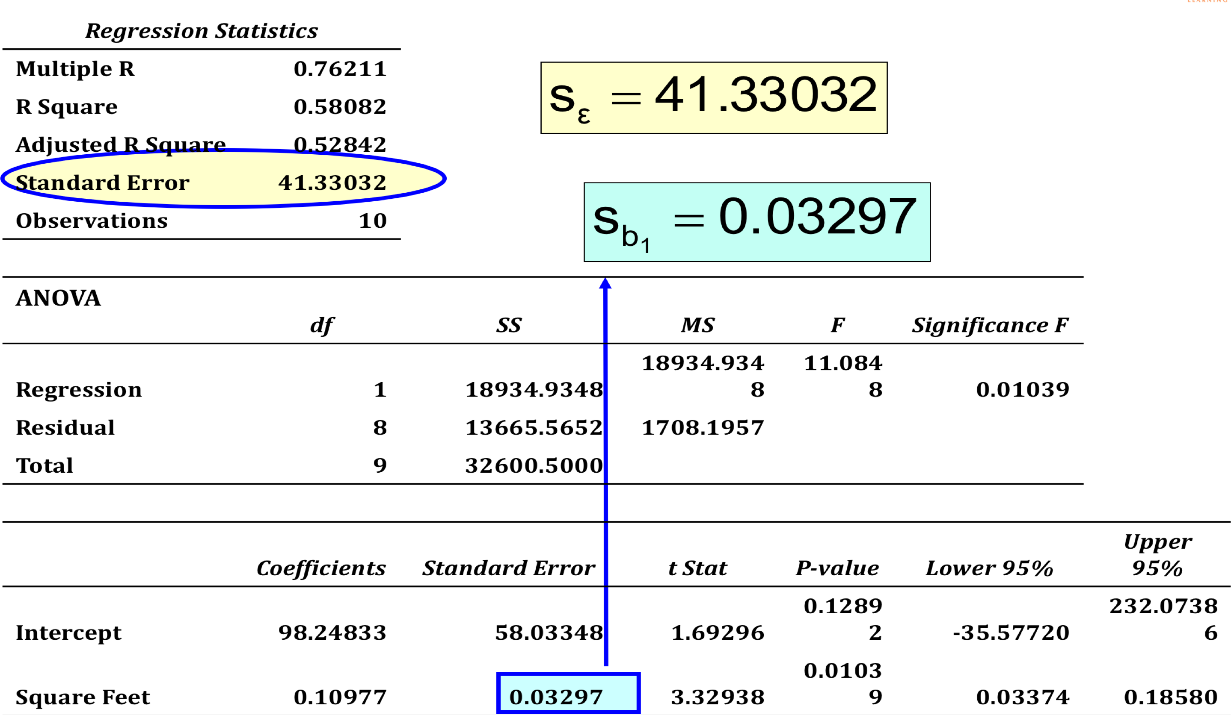

Slide 72

Comparing Standard Errors
Variation of observed y values from the regression line
y
Variation in the slope of regression lines from different possible samples
y
small s_{ε}
x
small s_{b}
1
x
y
y
large s_{ε}
x
large s_{b}
1
x

Slide 73
Inference about the Slope: t Test
T test for a population slope
o Is there a linear relationship between x and y?
Null and alternative hypotheses
H₀: β₁ = 0 (no linear relationship)
H₁: β₁ != 0 (linear relationship does exist)
_{t =} b₁ − β₁
where:
b₁ = Sample regression slope
coefficient
β₁ = Hypothesized slope
s_{b1} = Estimator of the standard
error of the slope
Test statistic
s
b₁
d.f. = n − 2

Slide 74
Inference about the Slope: t Test
House Price in $1000s (y) | Square Feet (x)
245 | 1400
312 | 1600
279 | 1700
308 | 1875
199 | 1100
219 | 1550
405 | 2350
324 | 2450
319 | 1425
255 | 1700
Estimated Regression Equation:
house price = 98.25 + 0.1098 (sq.ft.)
The slope of this model is 0.1098
Does square footage of the house affect its sales price?

Slide 75
Inference about the Slope: t Test Example
Test Statistic: t = 3.329
H₀: β₁ = 0
H_{A}: β₁ != 0
s_{b}
From output:
b
t
1
1
Coefficients
Standard Error
t Stat
P-value
Intercept
98.24833
58.03348
1.69296
0.1289
2
d.f. = 10-2 = 8
Square Feet
0.10977
0.03297
3.32938
0.0103
9
α/2=.025
α/2=.025
Decision:
Reject H₀
Conclusion:
There is sufficient evidence that square footage affects house price
Reject H₀ Do not reject H
Reject H₀
-
0
0
t
α/2
-2.3^{t}α0/260
2.3060
3.329

Slide 76
Regression Analysis for Description
Confidence Interval Estimate of the Slope:
^{b}1 ^{± t}α/2^{s}b
1
Excel Printout for House Prices:
d.f. = n - 2
 | Coefficient s | Standard Error | t Stat | P-value | Lower 95% | Upper 95%
Intercept | 98.24833 | 58.03348 | 1.69296 | 0.12892 | -35.57720 | 232.07386
Square Feet | 0.10977 | 0.03297 | 3.32938 | 0.01039 | 0.03374 | 0.18580
At 95% level of confidence, the confidence interval for the slope is (0.0337, 0.1858)

Slide 77
Regression Analysis for Description
 | Coefficient s | Standard Error | t Stat | P-value | Lower 95% | Upper 95%
Intercept | 98.24833 | 58.03348 | 1.69296 | 0.12892 | -35.57720 | 232.07386
Square Feet | 0.10977 | 0.03297 | 3.32938 | 0.01039 | 0.03374 | 0.18580
Since the units of the house price variable is $1000s, we are 95% confident that the average impact on sales price is between $33.70 and $185.80 per square foot of house size
This 95% confidence interval does not include 0.
Conclusion: There is a significant relationship between house price and square feet at the .05 level of significance

Slide 78
Confidence Interval for the Average y, Given x
Confidence interval estimate for the
mean of y given a particular x_{p}
Size of interval varies according to distance away from mean, x
(x − x)²
yˆ ± t s
1 _{p}
n ∑(x − x)²
+
α/2 ε

Slide 79
Confidence Interval for an Individual y, Given
x
Confidence interval estimate for an
Individual value of y given a particular x_{p}
(x − x)²
yˆ ± t s 1+
1 _{p}
n ∑(x − x)²
+
α/2 ε
This extra term adds to the interval width to reflect the added uncertainty for an individual case

Slide 80
Interval Estimates for Different Values of x
Prediction Interval for an individual y, given x_{p}
y
Confidenc e Interval for the mean of y, given x_{p}
+ b
x
□
1
y = b
0
x
x
x_{p}

Slide 81
Example
House Price in $1000s (y) | Square Feet (x)
245 | 1400
312 | 1600
279 | 1700
308 | 1875
199 | 1100
219 | 1550
405 | 2350
324 | 2450
319 | 1425
255 | 1700
Estimated Regression Equation:
house price = 98.25 + 0.1098 (sq.ft.)
Predict the price for a house with 2000 square feet

Slide 82
Example: House Prices
Predict the price for a house with 2000 square feet:
house price = 98.25 + 0.1098 (sq.ft.)
= 98.25 + 0.1098(2000)
= 317.85
The predicted price for a house with 2000 square feet is 317.85($1,000s) = $317,850

Slide 83
Estimation of Mean Values: Example
Confidence Interval Estimate for E(y)|x_{p}
Find the 95% confidence interval for the average price of 2,000 square-foot houses
□
Predicted Price Y_{i} = 317.85 ($1,000s)
1
(x − x)²
yˆ ± t s
p
+ = 317.85 ± 37.12
α/2 ε
n ∑(x − x)²
The confidence interval endpoints are 280.66 -- 354.90, or from $280,660 -- $354,900

Slide 84
Estimation of Individual Values: Example
Prediction Interval Estimate for y|x_{p}
Find the 95% confidence interval for an individual house with 2,000 square feet
□
Predicted Price Y_{i} = 317.85 ($1,000s)
1
(x − x)²
yˆ ± t s 1+ +
p
= 317.85 ± 102.28
α/2 ε
n ∑(x − x)²
The prediction interval endpoints are 215.50 -- 420.07, or from $215,500 -- $420,070

Slide 85
Linear Regression with Gradient Descent
Congratulations! That’s the first step in your machine learning and artificial intelligence journey.
Get an intuitive feel for how gradient descent works because this is actually used in more advanced models also.

Slide 86
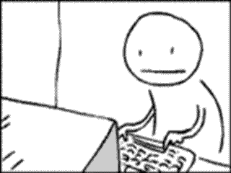
How hard it is to code?

Slide 87
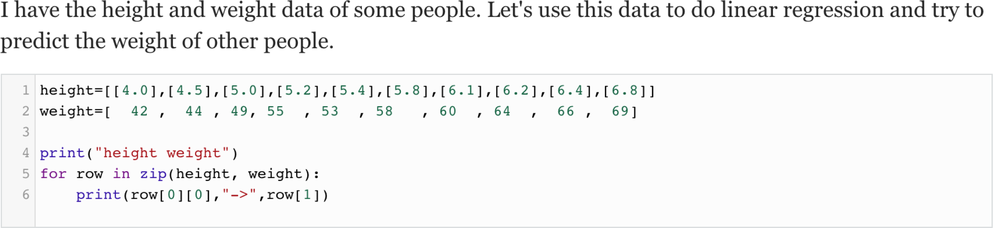
Step 1
Step 2

Slide 88
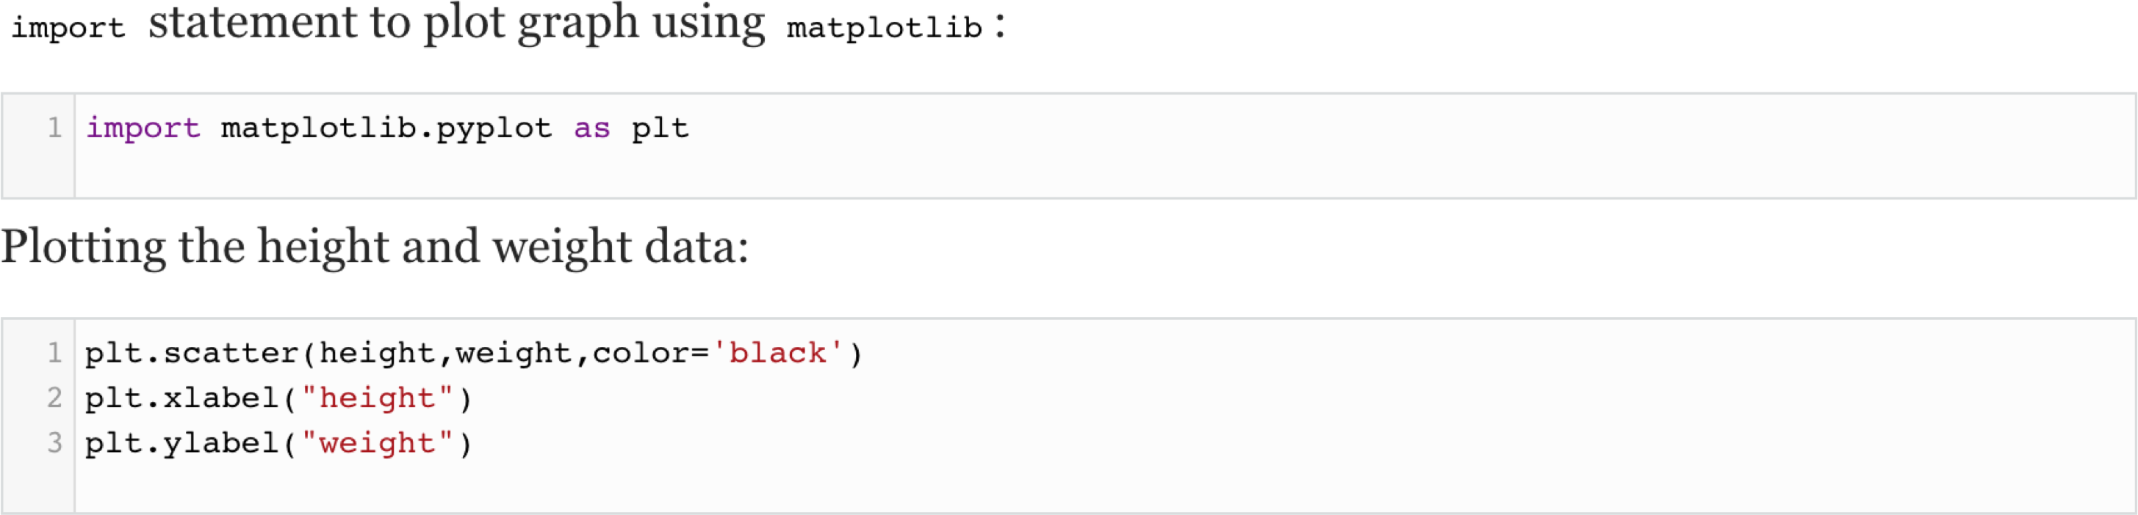
Step 3

Slide 89
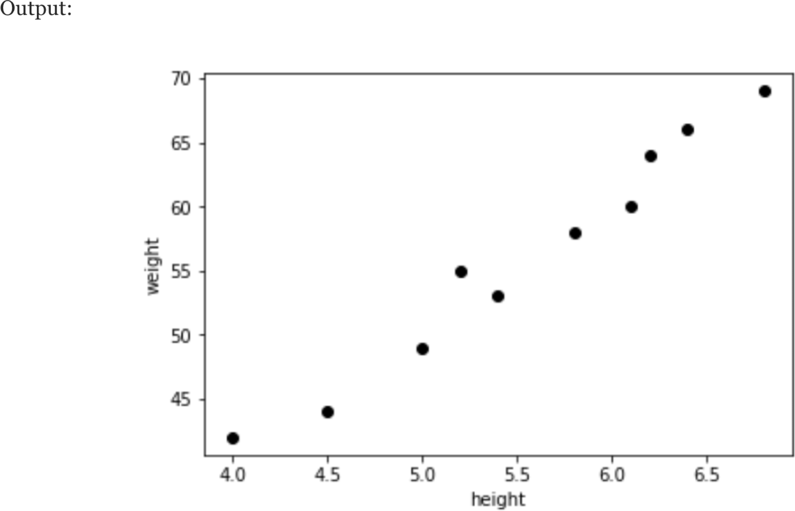

Slide 90
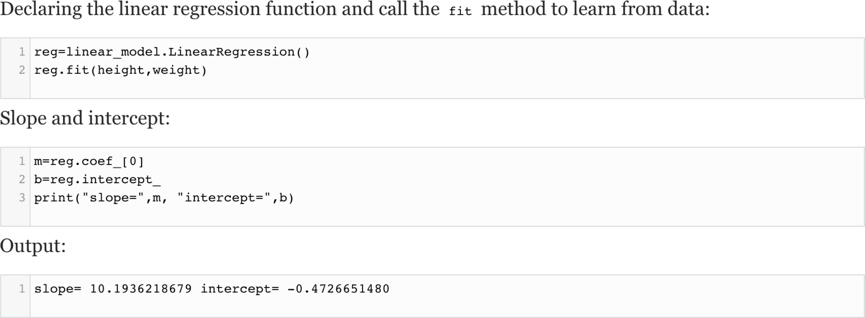
Step 4

Slide 91
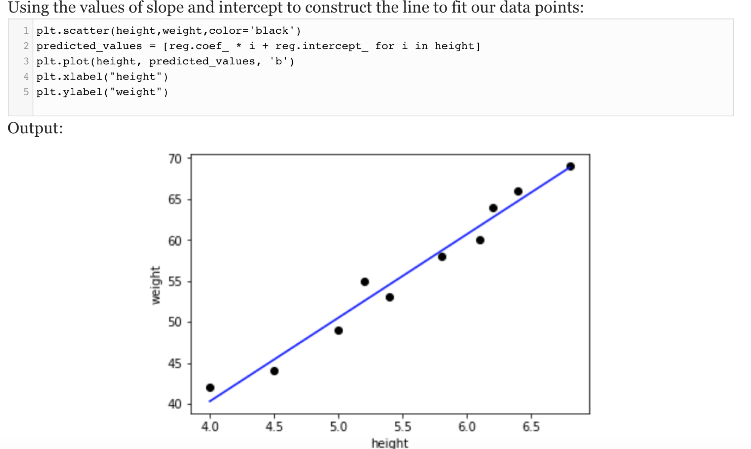
Step 5

Slide 92
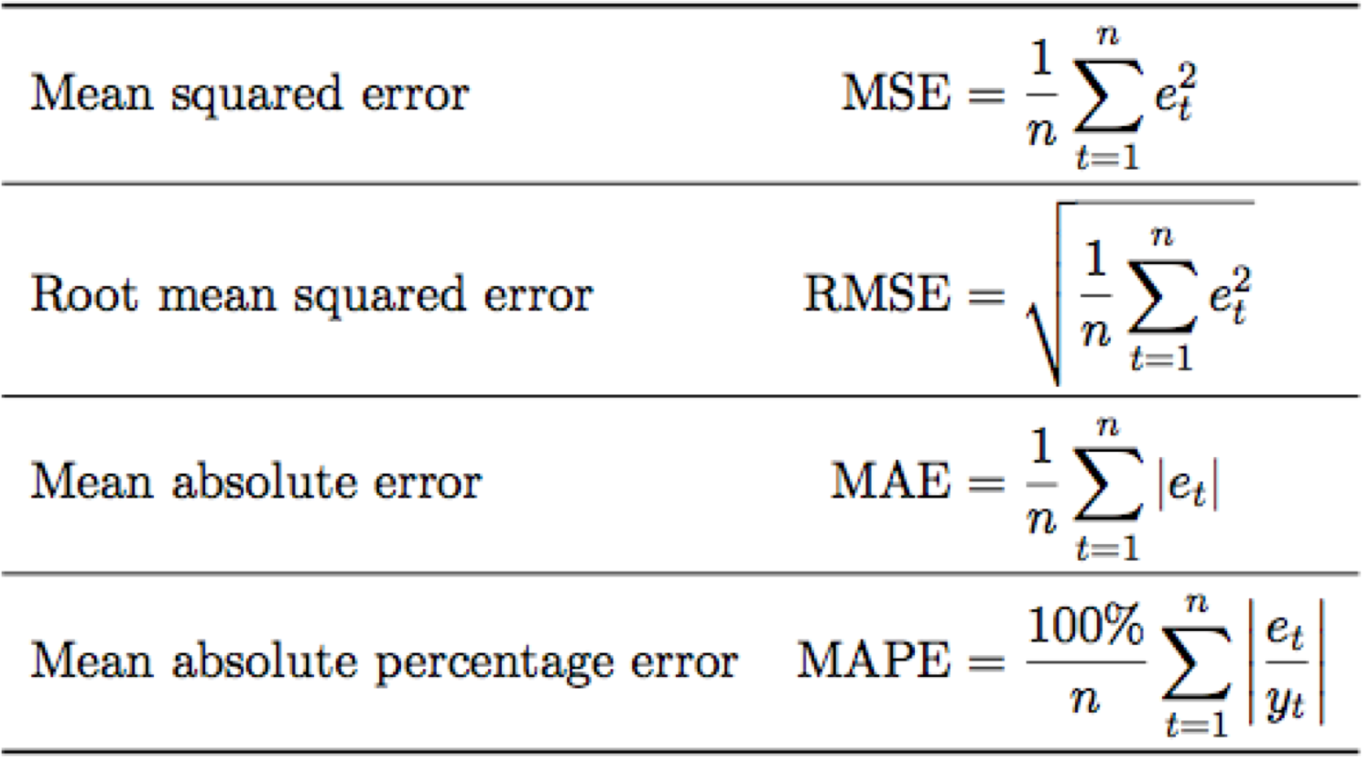
Error Metrics

Slide 93
Advantage of Linear Regression
Linear regression implements a statistical model that, when relationships between the independent variables and the dependent variable are almost linear, shows optimal results.
Best place to understand the data analysis
Easily Explicable

Slide 94
Disadvantages
Linear regression is often inappropriately used to model non-linear relationships.
Linear regression is limited to predicting numeric output.
A lack of explanation about what has been learned can be a problem.
Prone to bias variance problem

Slide 95
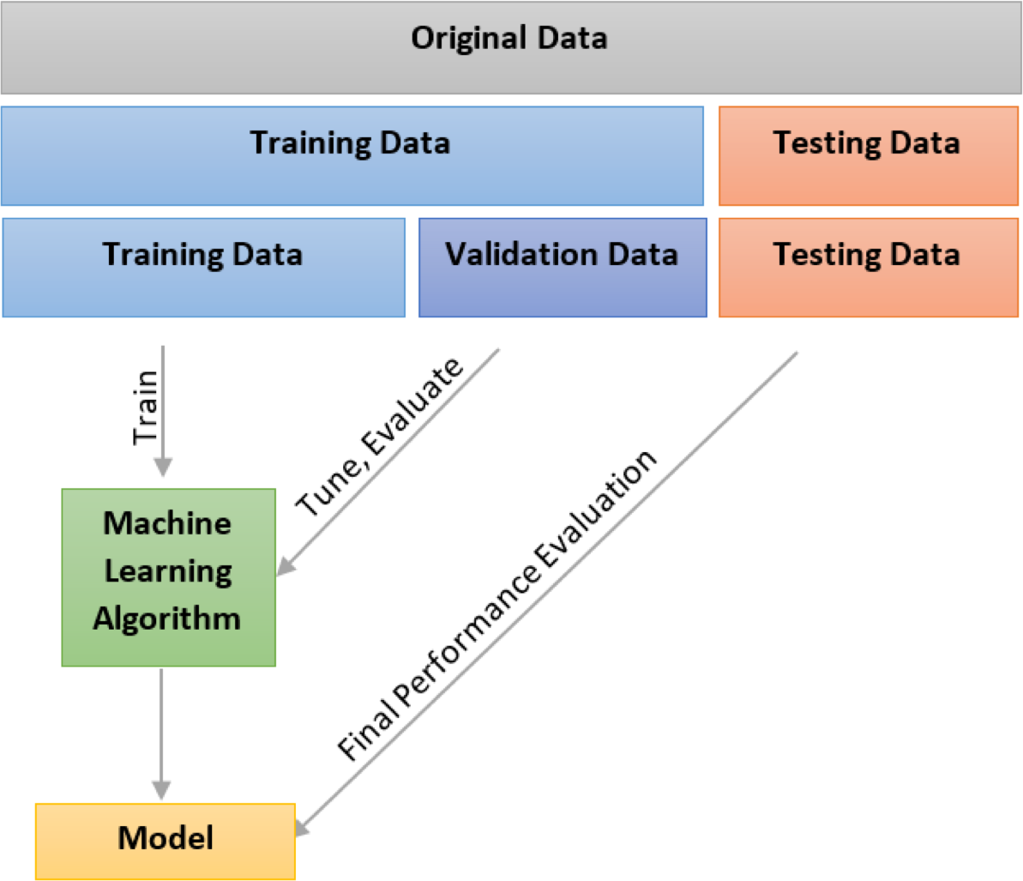
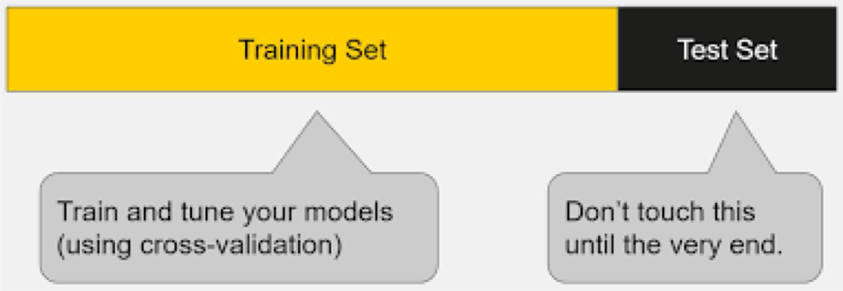
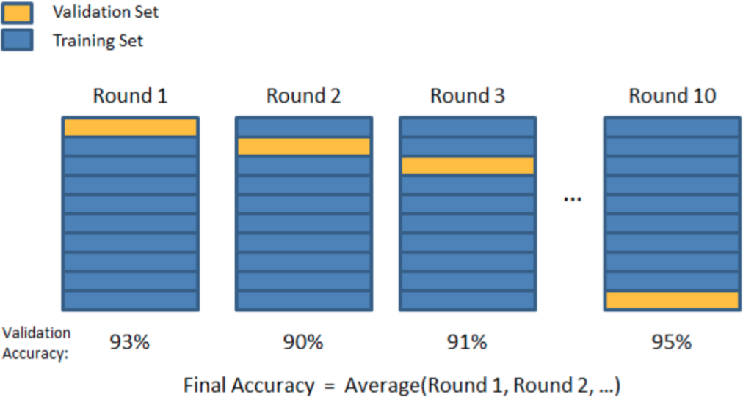
How to evaluate our model?

Slide 96
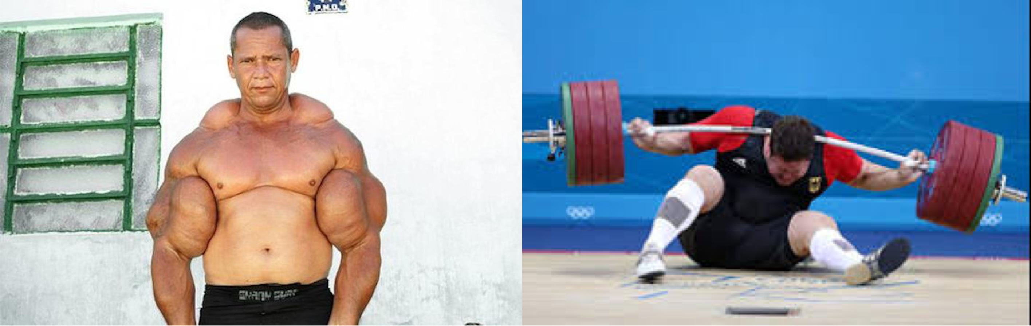
Overfitting vs Underfitting
Training Data(Less Error)
Testing Data (More Error)

Slide 97
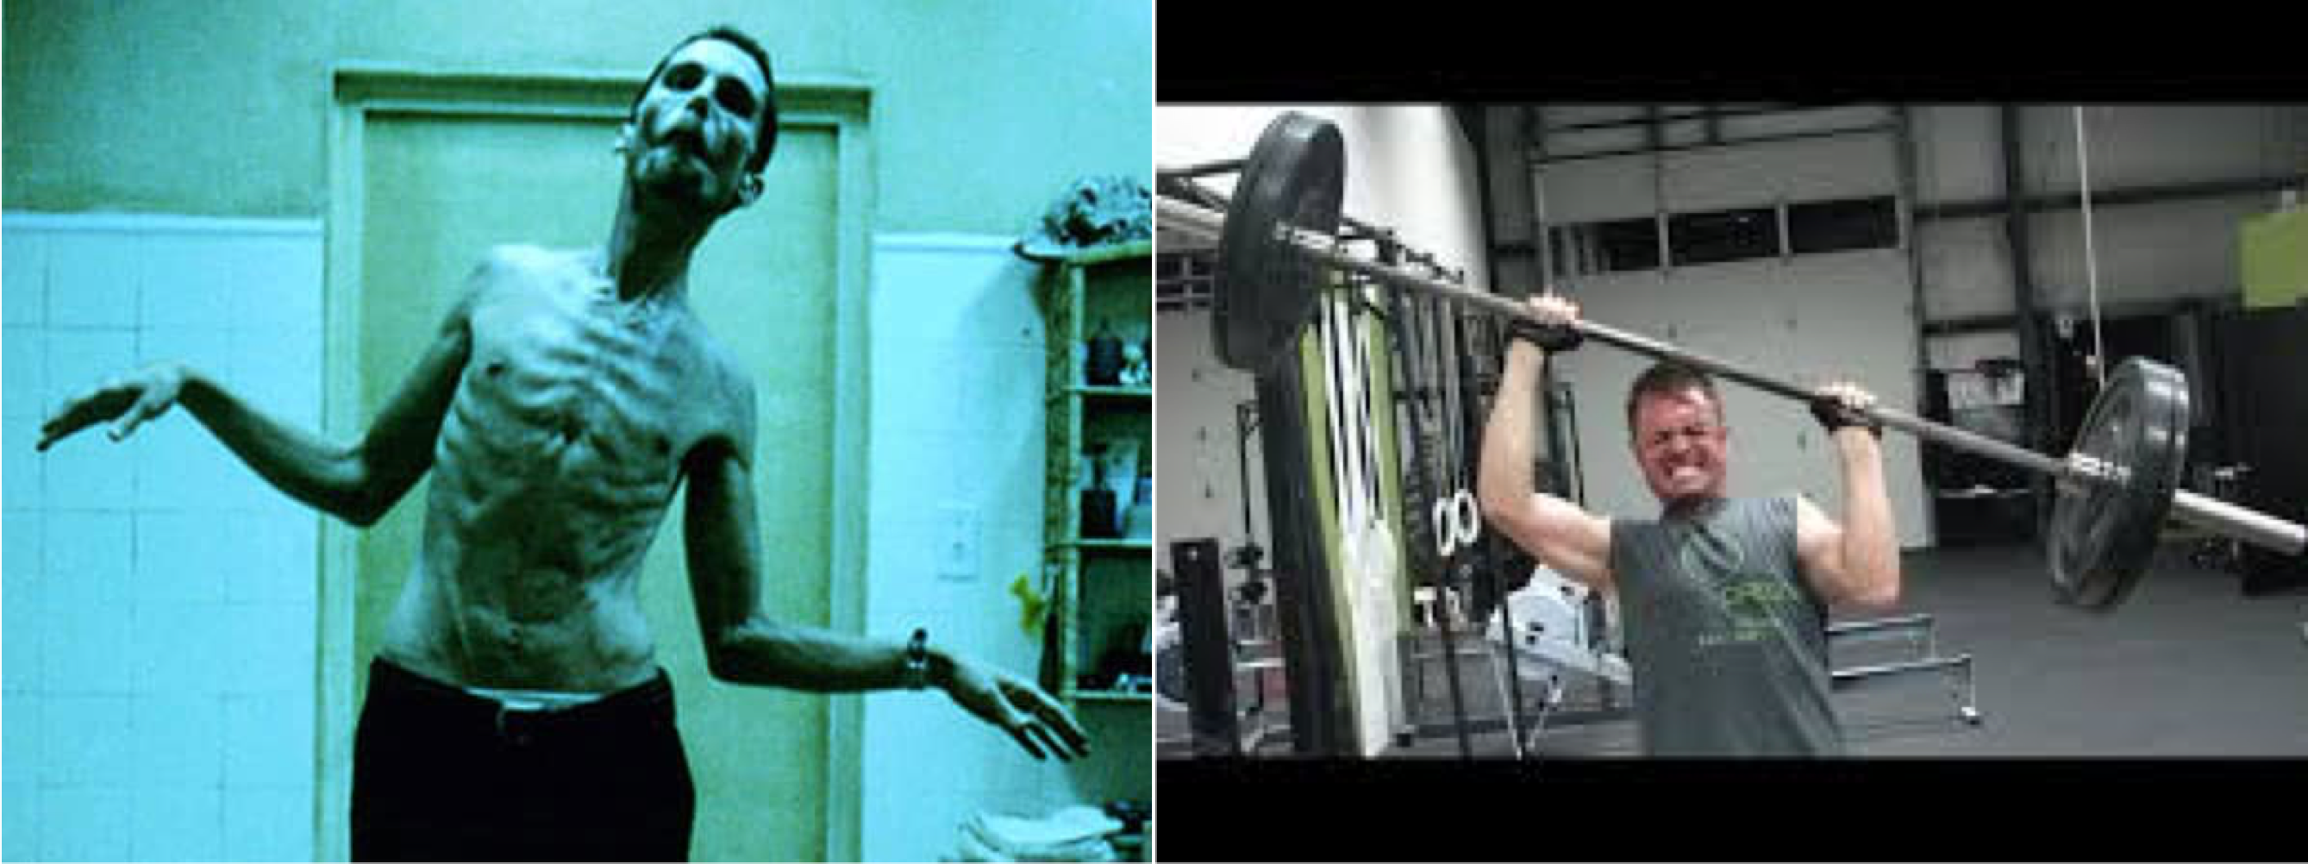
Overfitting vs Underfitting
Training Data (More Error)
Testing (Still More Error)

Slide 98


Variance and Bias Trade off
Ideal Model should have Low varinance and Low Bias

Slide 99


